Slide 1


React
Redux
Alex Chen
2016/06/29

Slide 2
Why We Use It?

Slide 4
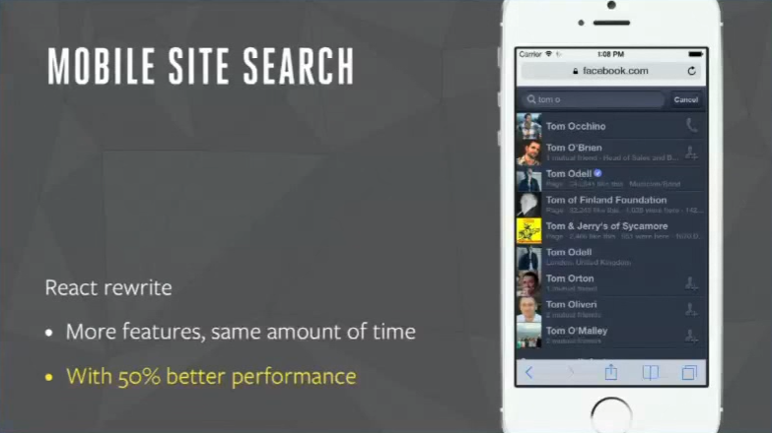
Facebook Empirical

Slide 5
How To Do That?

Slide 6
Let Code Be
More Predictable !

Slide 7
Predictable Code
Predictable
Data
Predictable
UI
Redux
React

Slide 8
Redux

Slide 9
The MVC Problem Is… Scale

Slide 10
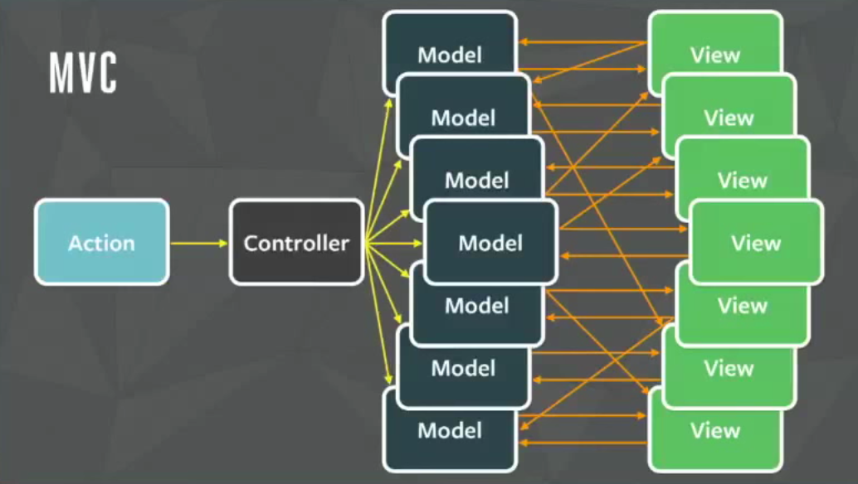

Slide 11
It’s so hard to predict who changed the model.
The controller own too much duty.
It’s difficult to keep all view’s status in sync.

Slide 12
CASE STUDY Receive new chart message

Slide 13
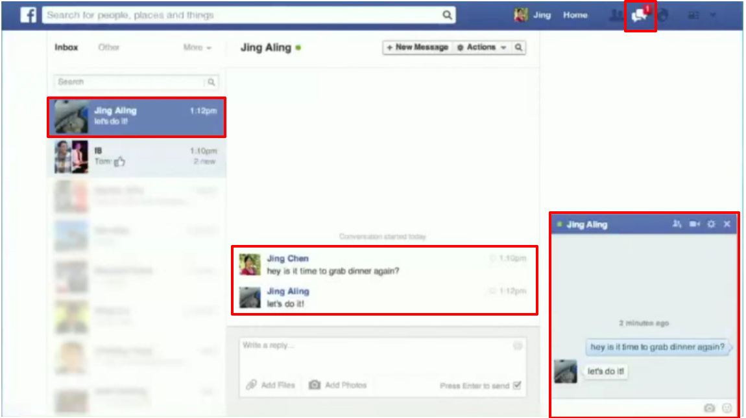

Slide 14
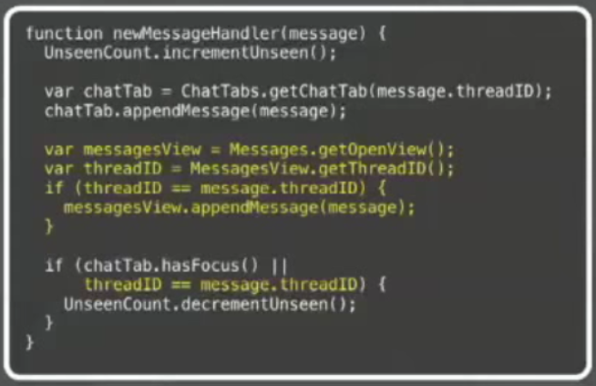
Increment unseen thread count.
Append message in chat tab.
If open, append message in main messages view.
If chart tab is focused or main messages view is open, decrement unseen count.
Notes:
One is that the code really has no structure
• It's very imperative which makes it fragile
• We lose a lot of the original intent behind it
§ It's hard to tell just by looking at the code that you want to keep the messages view and the chat
view in sync
§ It's hard to tell that you only want to increment and then decrement. You don't want to do
either of those more than once
§ As we add more features, this code just only gets longer

Slide 15
Decentralized

Slide 16
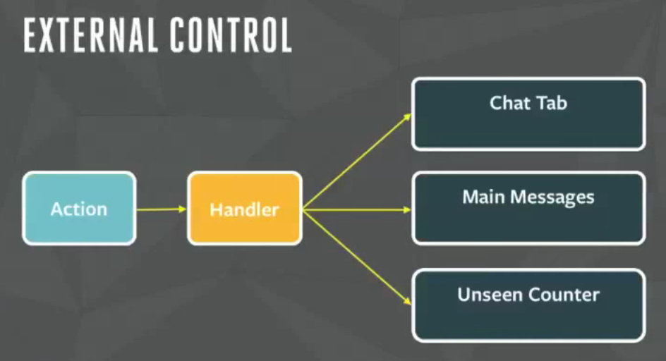
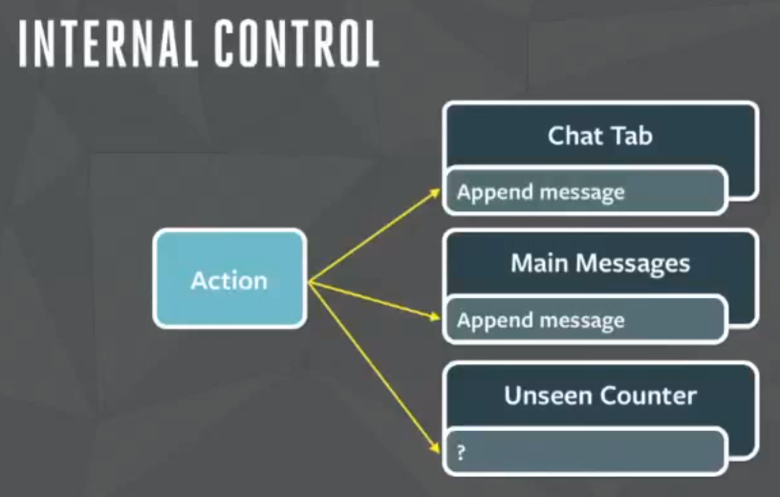

Slide 17
Single Source Of Truth
Notes:
Explicit Data Instead Derived Data
Separate Data From View State
Separate Data From View State

Slide 18
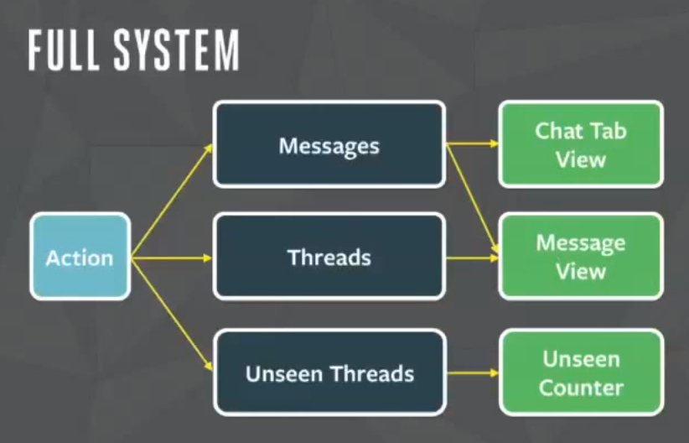

Slide 19
Single Direction Data Flow
Notes:
Explicit Data Instead Derived Data
Separate Data From View State
Separate Data From View State

Slide 20
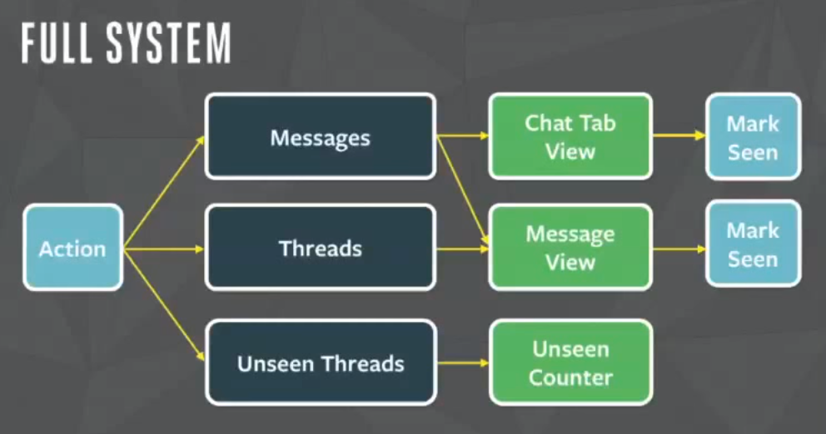

Slide 21
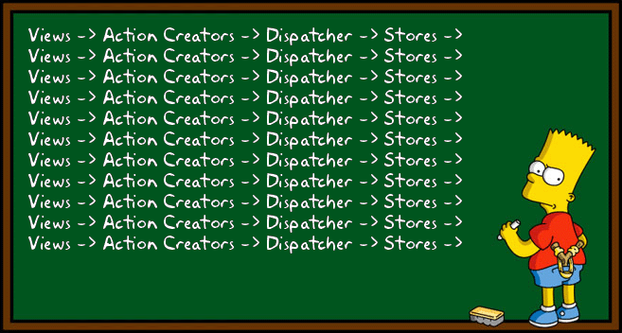

Slide 22

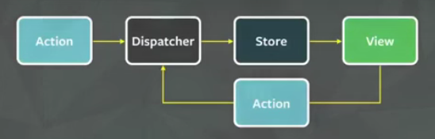

Slide 23
It’s so hard easy to predict who changed the model.
The controller Every store own too much their duty.
It’s difficult 100% to keep all view’s status in sync.

Slide 24

Gaearon (Dan Abramov)
Live react: hot reloading with time travel at react-Europe 2015
Status Quo
Refresh on every change.
Reproduce the state.
Repeat the actions.
It can be fixed
Most changes aren’t drastic
Preserve the state
Recover from errors.
Notes:
Refresh on every change.
Reproduce the state.
Repeat the actions.
Based on most changes aren’t drastic
Preserve the state
Recover from errors.

Slide 25
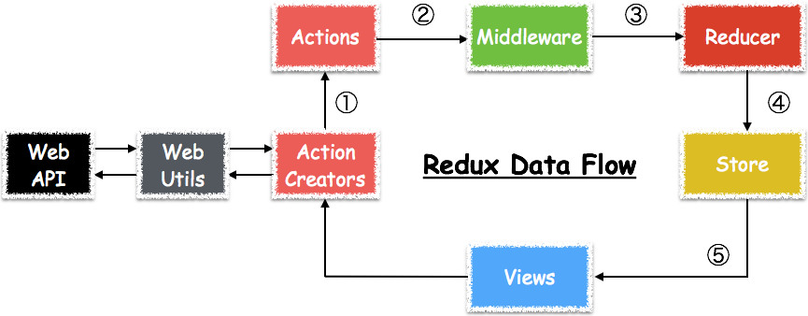
Three Principles
Single source of truth
The state of your whole application is stored in an object tree within a single store.
State is read-only
The only way to mutate the state is to emit an action, an object describing what happened.
Changes are made with pure functions
To specify how the state tree is transformed by actions, you write pure reducers.

Slide 26
Reducer(reducing function)
type Reducer<S, A> = (state: S, action: A) => S
A reducer is a function that accepts an accumulation and a value and returns a new accumulation. They are used to reduce a collection of values down to a single value.
They must be pure functions—functions that return the exact same output for given inputs. They should also be free of side-effects.

Slide 27
React

Slide 28
Server Page
Recreate whole HTML on every update
Angular
Declaratively manipulating data & template
Re-render by watch dog
Framework manipulating DOM
jQuery
Re-render on every update
Programmatically manipulating DOM
React
Declaratively manipulating component
Re-render on every update
Framework manipulating DOM and speed up by VDOM

Slide 29
Component-Based
Separation of concerns
Notes:
Explicit Data Instead Derived Data
Separate Data From View State
Separate Data From View State

Slide 30
Separation of concerns
Reduce coupling, increase cohesion.

Slide 31
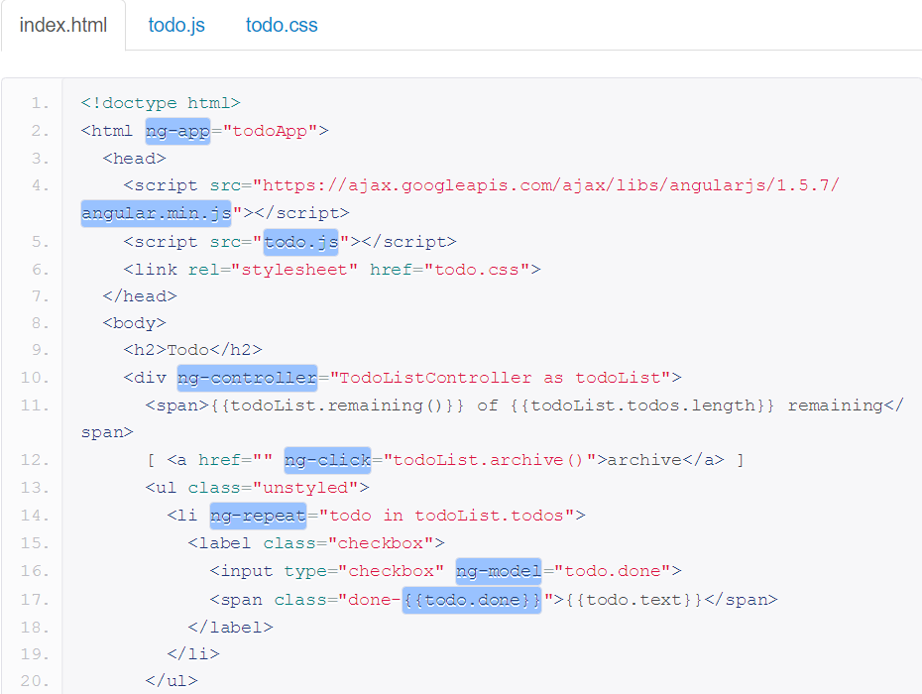
Case Study

Slide 32
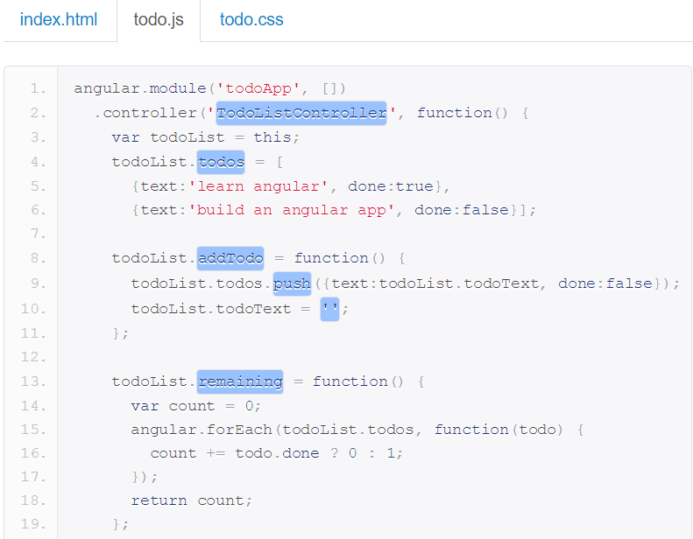
Case Study

Slide 33
View model tightly couples template to display logic.
{price:7.99,cellColor:#FFFFFF}
Display logic and template are inevitably tightly coupled.
How do you find DOM nodes?
Display logic and template are inevitably highly cohesive.
They both show the UI
Inventing lots of new concepts (that already exist in JavaScript.)
Templates separate technologies, not concerns.

Slide 34
React component.
A highly cohesive building block for UIs ,
loosely coupled with other components
Anything is JavaScript.

Slide 35
React component.
Is a JavaScript Class with render() method. Render Method will recursively call children render().The input is state and the output is JavaScript object tree.
Transformation
Abstraction
Composition
Memoization
Notes:
Transformation: State machine.

Slide 36
React.DOM.a(
{href:'http://yahoo.com.tw'}
,'YAHOO'
)
JSX :
Xml-like syntax extension to ECMASCRIPT.
<a href:'http://yahoo.com.tw‘>
YAHOO
</a>

Slide 37
Re-render on every update
Because React components are basically just idempotent functions.
Every place data is displayed is guaranteed to be up-to-date.
No magical data binding & model dirty checking

Slide 38
Virtual DOM
(and events system)
Optimized for performance and memory footprint.

Slide 39
On every update
React builds a new virtual DOM subtree
Diffs it whit the old one.
Computes the minimal set of DOM mutations and puts them in a queue.
Batch executes all updates.

Slide 40
